Slide 1

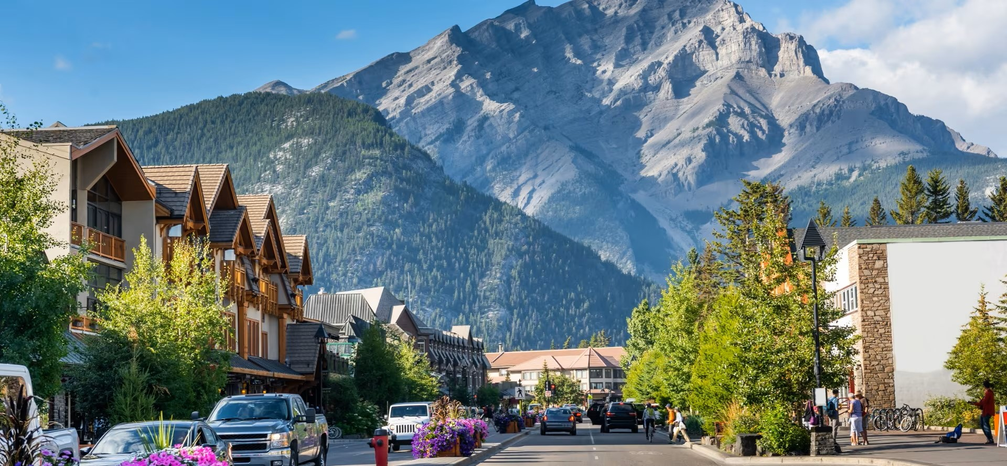
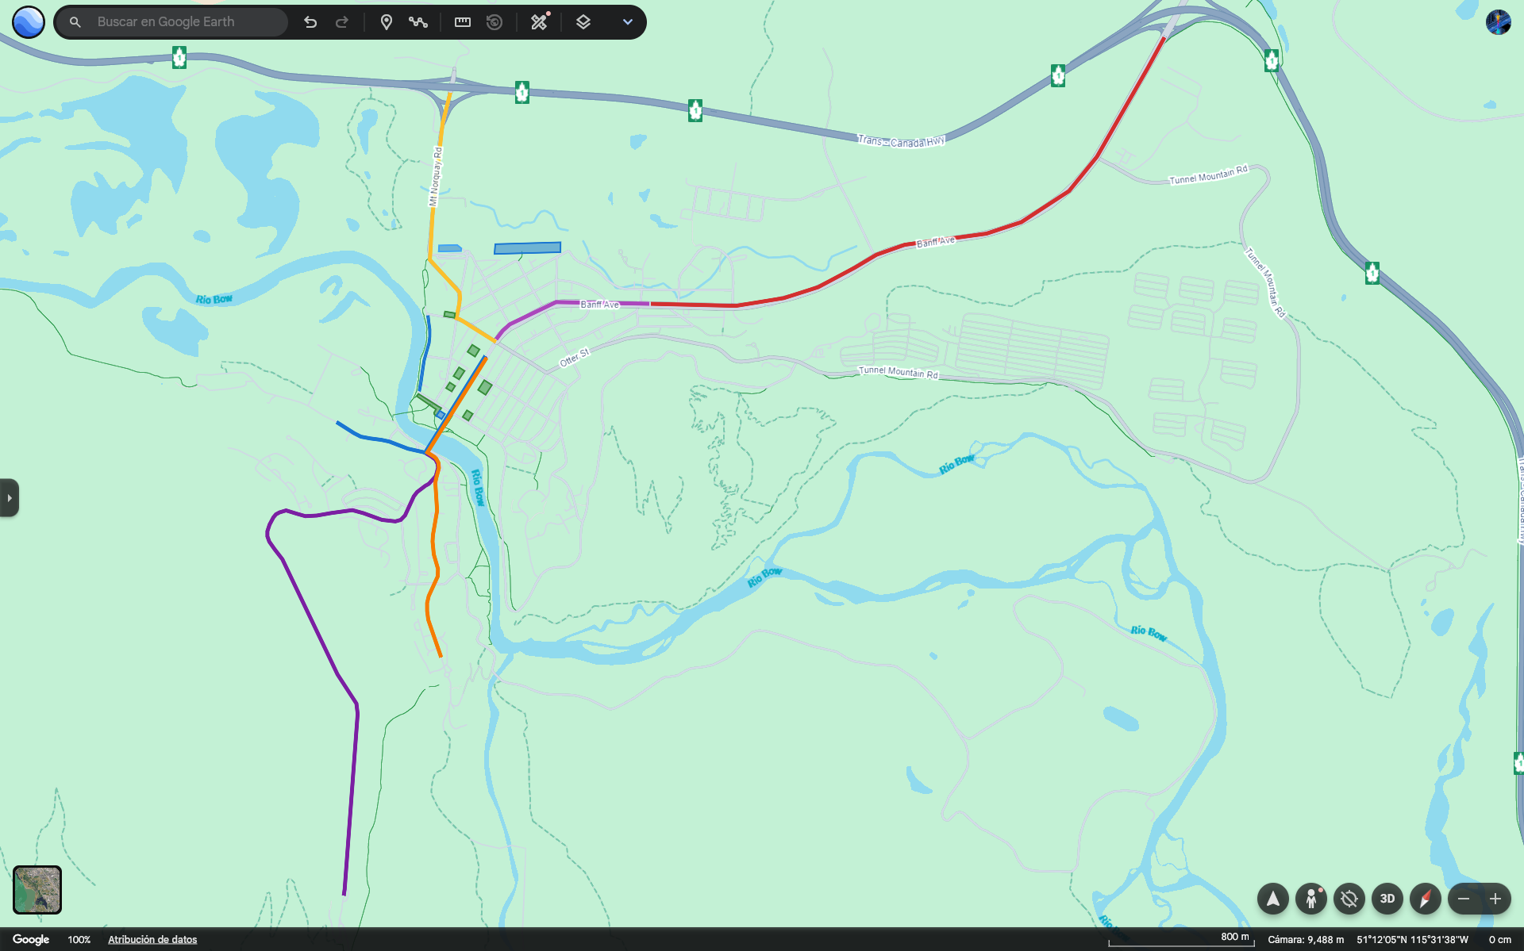
October 10, 2029
CMPT-3835-Machine Learning Work Integrated Project II
Mobility Innovator
Banff Traffic Management
Instructor Name: Uchenna Mgbaja, Palwasha Afsar

Slide 2
October 20, 2029
CMPT-3835-Machine Learning Work Integrated Project II
Mobility Innovator
Banff Traffic Management
Aquiles Escarra
Inderjeet Singh
Aditya Mehta
Yungvir Singh
Instructor Name: Uchenna Mgbaja, Palwasha Afsar

Slide 3


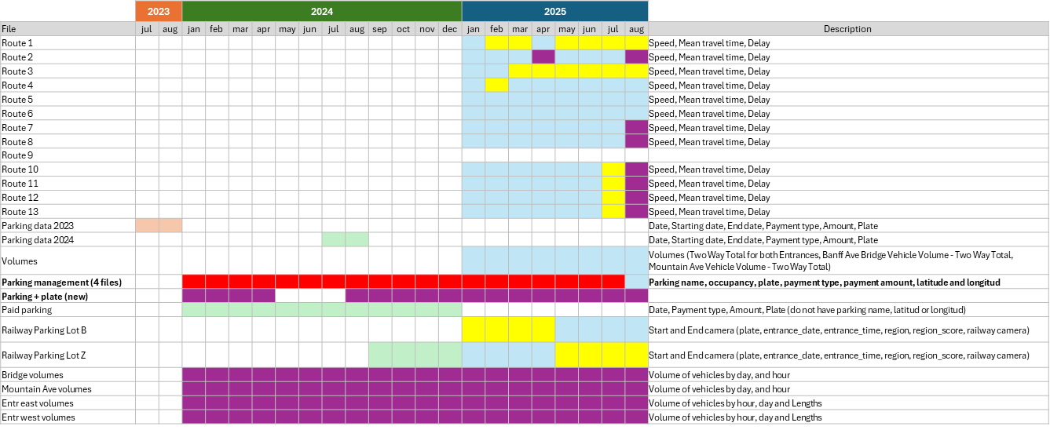

Problem Statement
Data
Regression
Predict hourly parking occupancy in Banff to understand temporal demand patterns and optimize parking availability.
Detect when parking lots reach saturation (≥90% occupancy) to support real-time management and visitor guidance.
Classification
CornerStone Solutions Inc

Slide 4
Problem Statement
Data
Regression
Predict hourly parking occupancy in Banff to understand temporal demand patterns and optimize parking availability.
Detect when parking lots reach saturation (≥90% occupancy) to support real-time management and visitor guidance.
Analyze how traffic congestion on the Bow River bridge affects parking behavior in nearby tourist and hotel zones.
Classification
Correlation / Analysis
CornerStone Solutions Inc

Slide 5
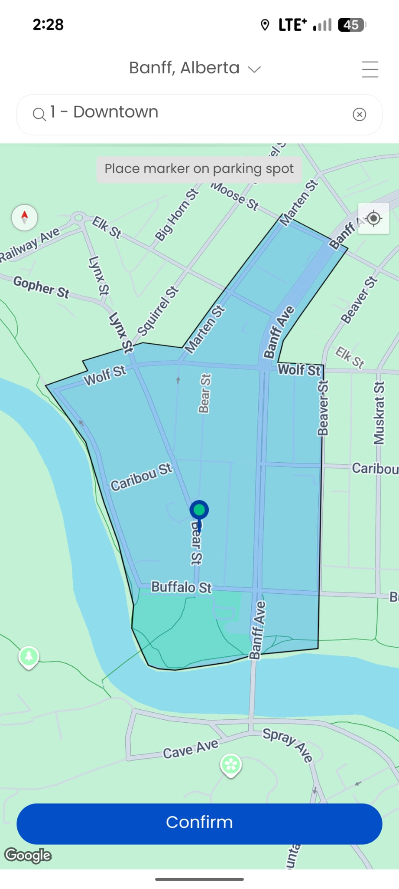
Data
Traffic Volume
Parking
Features: Fee, Date, Starting date, End date, Payment type, Amount, Plate, Type, Hope Gps Latitude, Hope Gps Longitude, Unit, Time, PT1 amount, Amount with bonification, Zone.
Features: date, volume, direction, artery.
Rows: 1,051,334
28 Parking lots + BANFF99V- Virtual & TEST
Pay by phone do not have parking lot assign
Duplicate rows found: 148
21 Rows where Plate = TEST
Records with invalid time intervals: 164
Rows: 116,928
387 missing values in Mountain Ave (~16 days)
Removed 772 rows in all directions (sensor downtime)
Parking
CornerStone Solutions Inc
Parking time range: 2024-01-01 08:00:00 → 2025-09-01 09:00:00
Traffic time range: 2024-01-01 01:00:00 → 2025-09-01 00:00:00

Slide 6
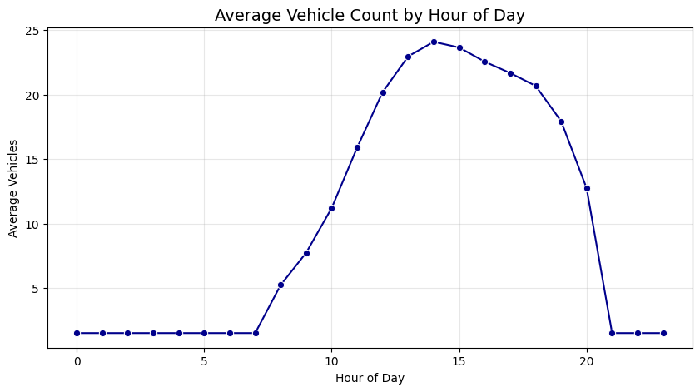
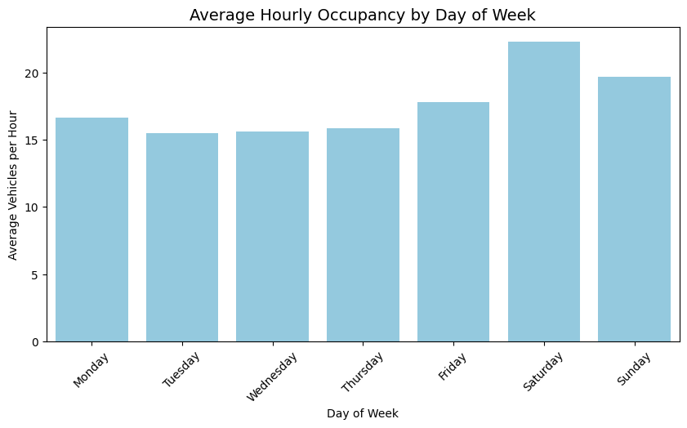
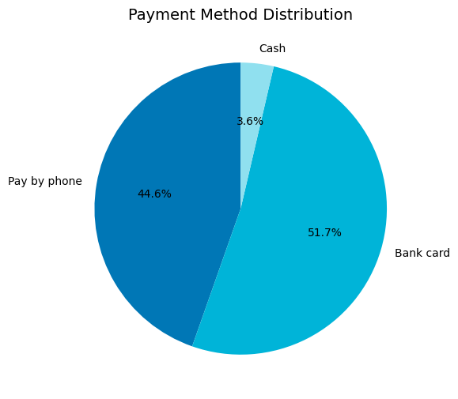
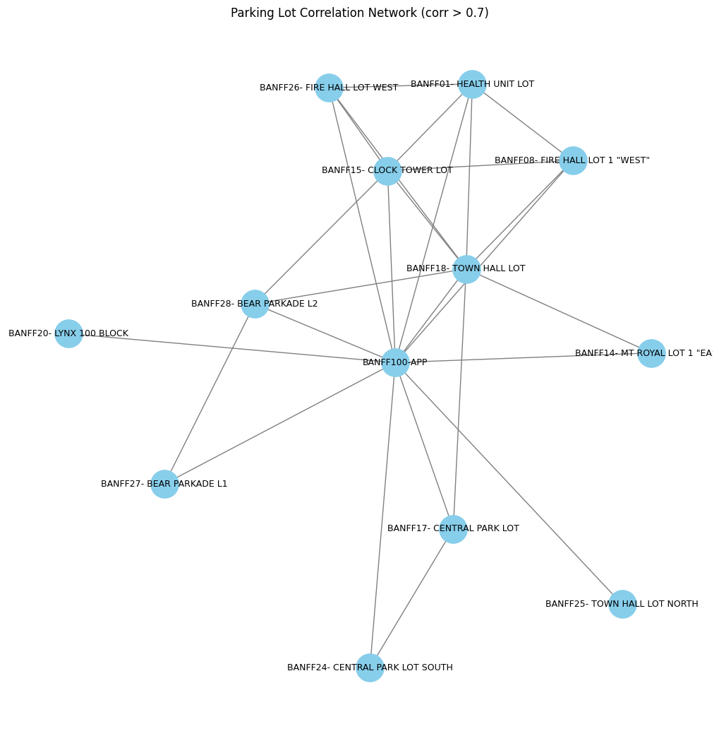
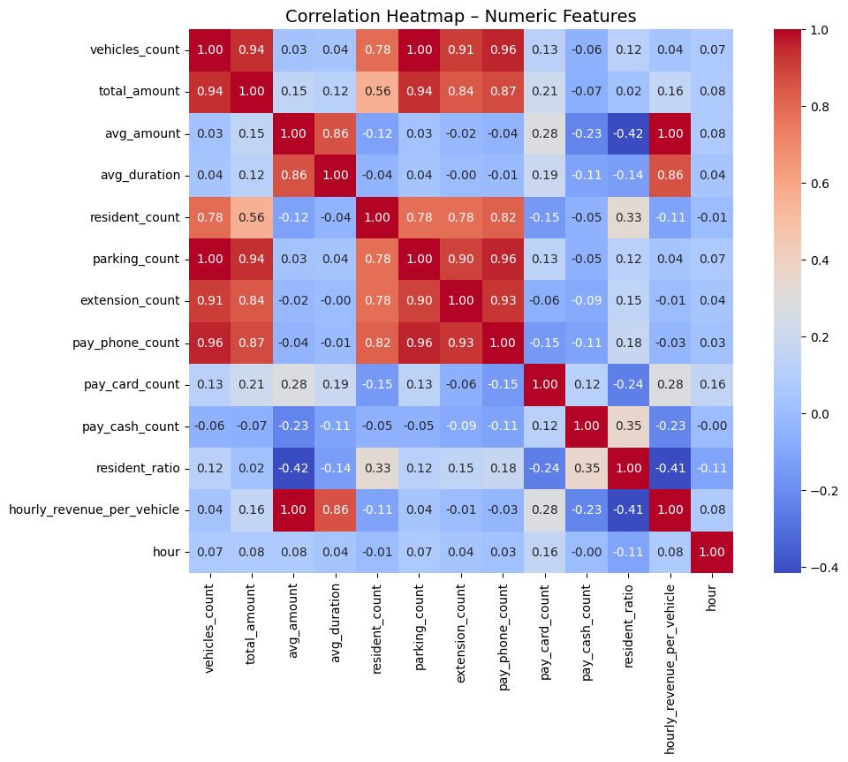
Parking

Slide 7
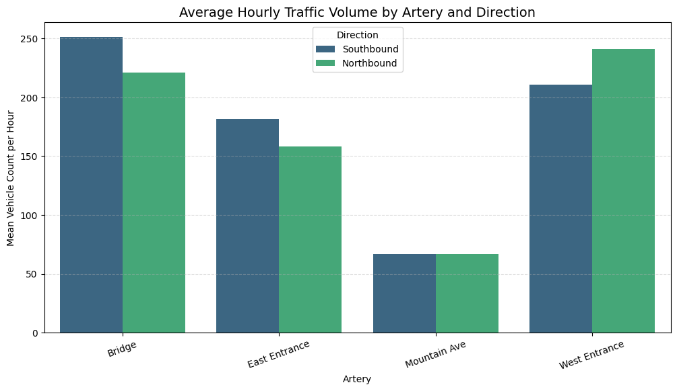
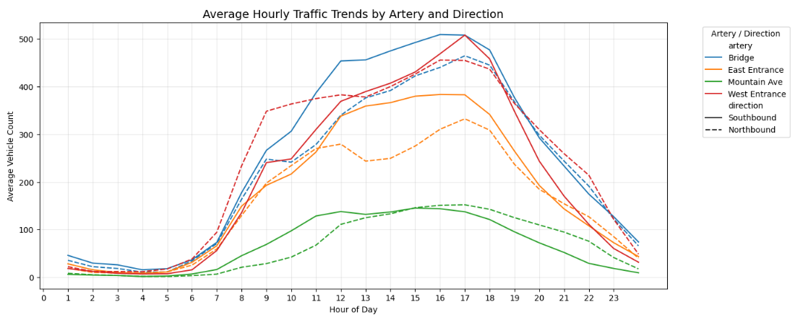
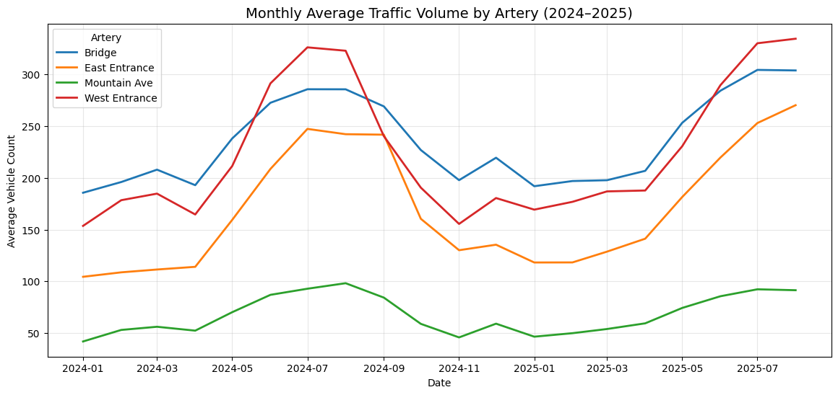
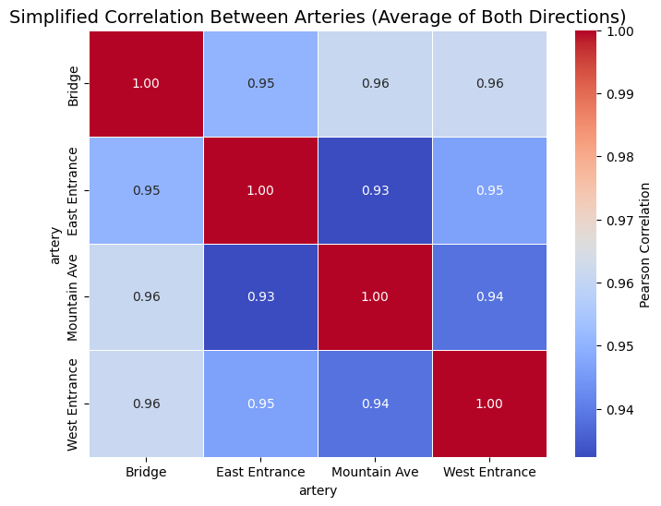
Traffic

Slide 8
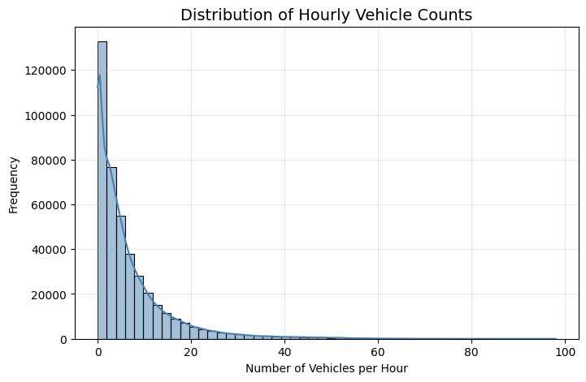
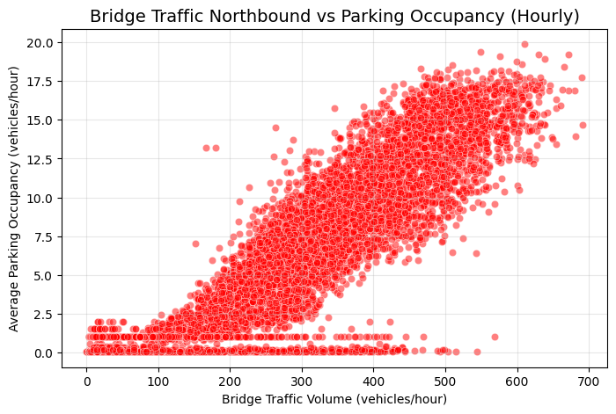
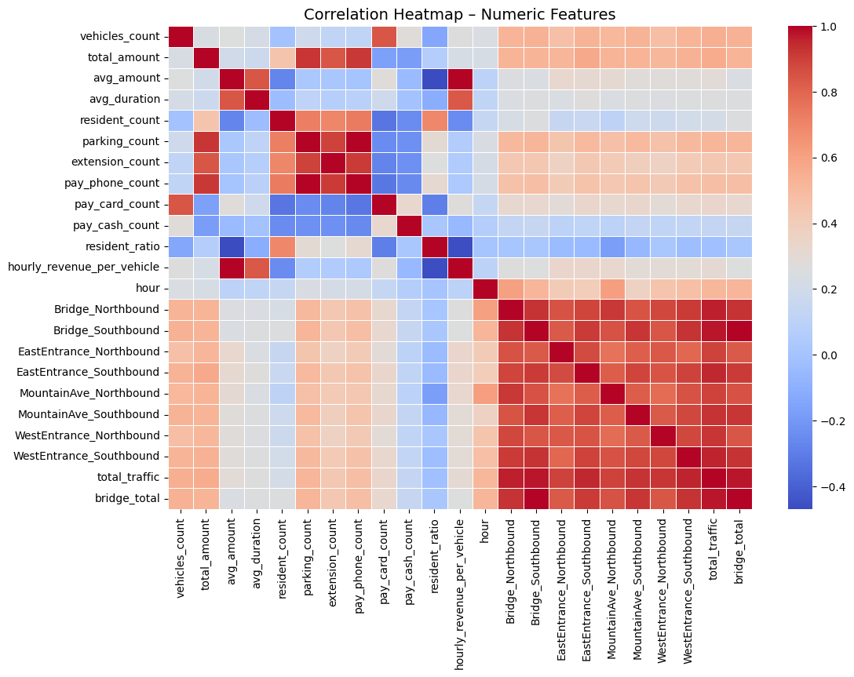
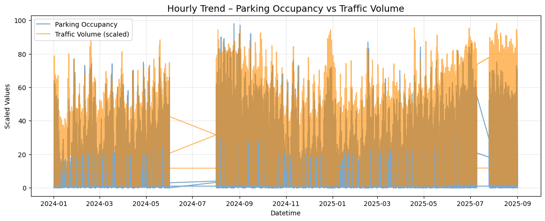
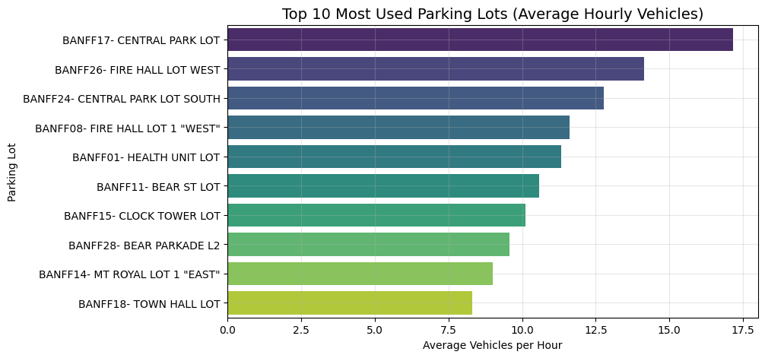
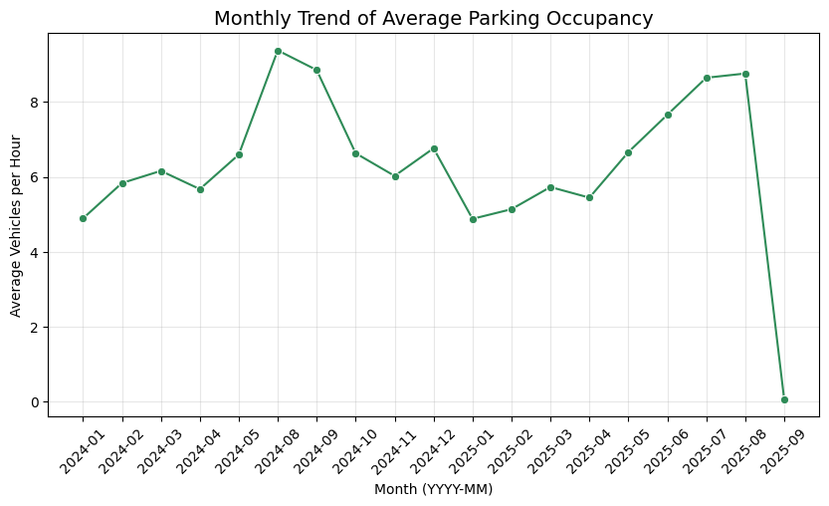
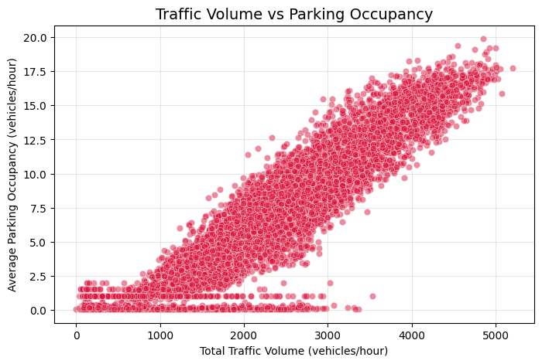
Consolidated EDA
Features:
Parking:
timestamp
cars_in_lot
avg_parking_duration_min
Traffic:
datetime
Bridge_Northbound
Bridge_Southbound
EastEntrance_Northbound
EastEntrance_Southbound
MountainAve_Northbound
MountainAve_Southbound
WestEntrance_Northbound
WestEntrance_Southbound
Filter hours (8 AM - 8 PM)
Consolidated dataset:
7,125 rows
10 columns

Slide 9
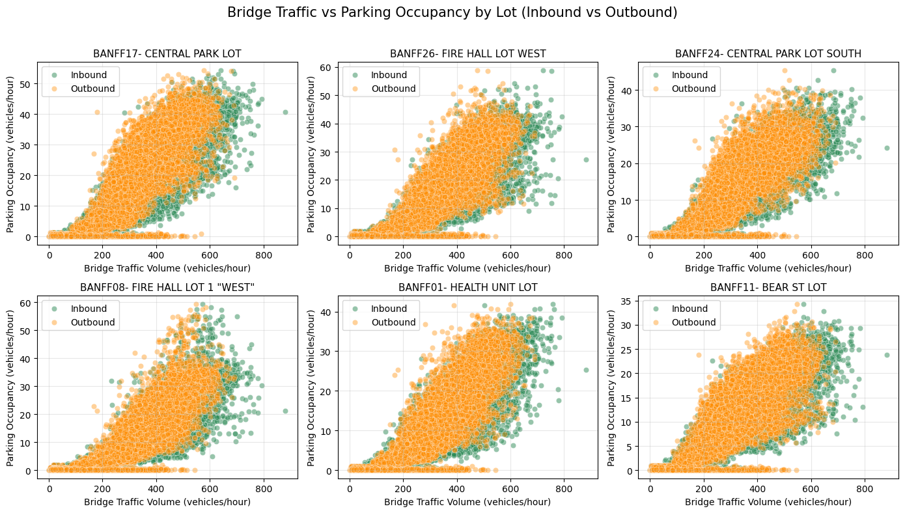
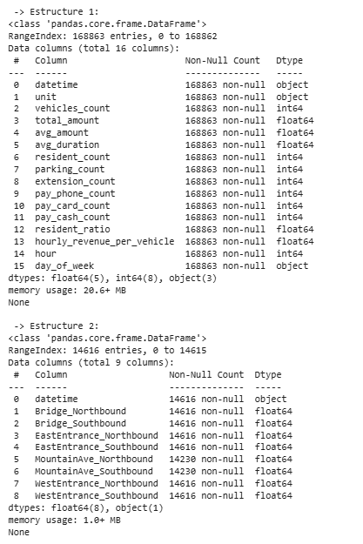
Consolidated EDA

Slide 10
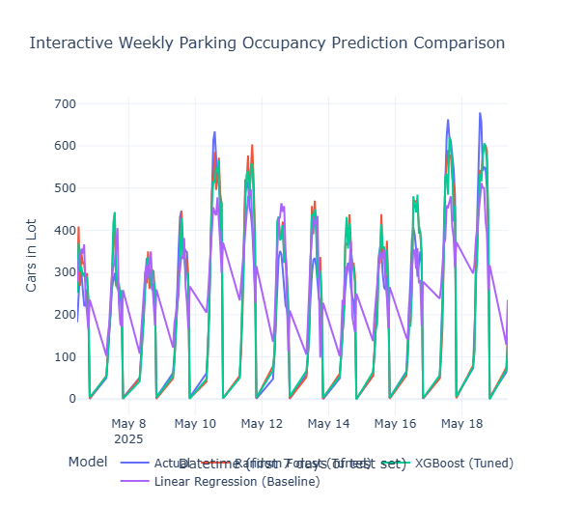
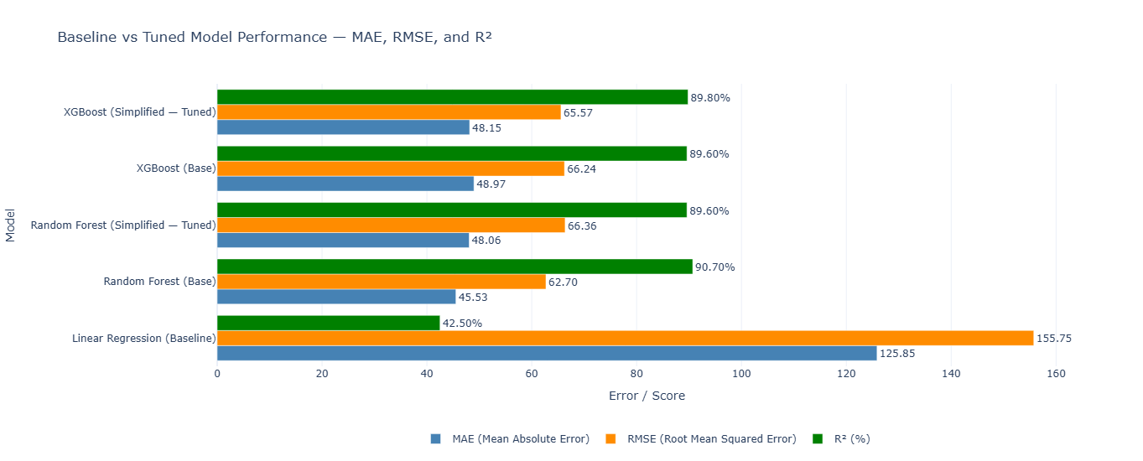
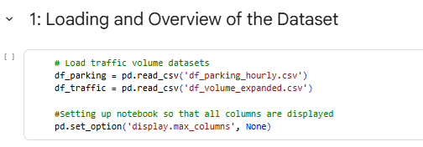
ML Modeling and Optimization

Slide 11
Conclusions
Integrated Traffic-Parking Insight
The combined datasets revealed a consistent relationship between parking occupancy and traffic volume at key .
Temporal Patterns as Predictive Drivers
Hourly and daily trends proved to be critical features, with strong seasonal and weekend effects visible across both parking and traffic datasets.
Data Availability Limitation
A major limitation identified was the lack of detailed occupancy data for users who pay through the mobile app.
Vehicle speed data from road sensors could have offered meaningful patterns for modeling traffic–parking interactions.
*by aligning our problem statement with the true structure of the data, we transform a limitation into an opportunity — focusing our analysis where it can produce the most actionable insights for the client.
Notes:
One of the main challenges identified during this project was the limited spatial information for transactions made through the Banff Parking App, which represent nearly 50% of all parking records. Because these app-based transactions do not include a fixed parking location, the original modeling objective — predicting occupancy per parking lot — could not be achieved without introducing strong assumptions that would compromise model reliability.
2. Despite this limitation, the data analysis provided valuable insights:
Parking follows a clear daily cycle, with peak demand between 10 AM and 5 PM, especially on weekends and summer months.
Parking demand is higher from June to August, reflecting Banff’s tourism season, while winter months show lower activity.
App users park more frequently but for shorter periods, while on-site payments show longer stays and higher spending, suggesting different usage profiles between residents and visitors.
These insights already contribute to a better understanding of citywide parking dynamics.
3. In response to the data constraints, the project scope was strategically redefined to focus on questions that can be fully supported by the available data and still deliver value to the client. The new problem statements aim to:
Predict parking duration (Regression).
Forecast overall parking demand across time and payment modes (Time-Series / Analysis).

Slide 12
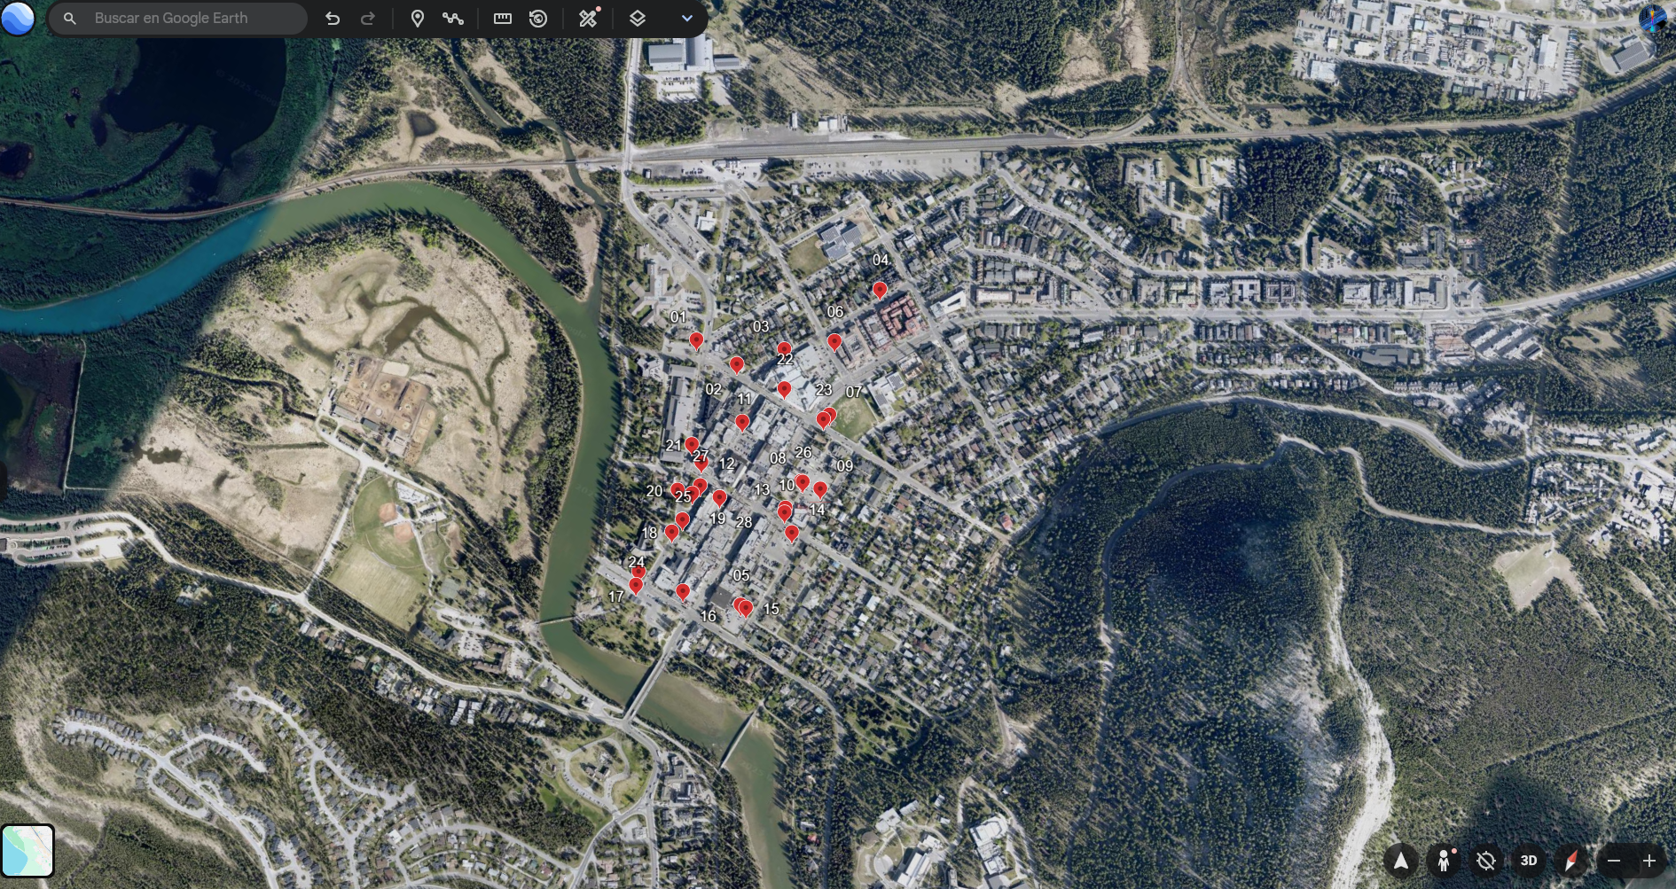
East Entrance
West Entrance
Bridge
Mountain Ave

Slide 13
Thanks!

Slide 14
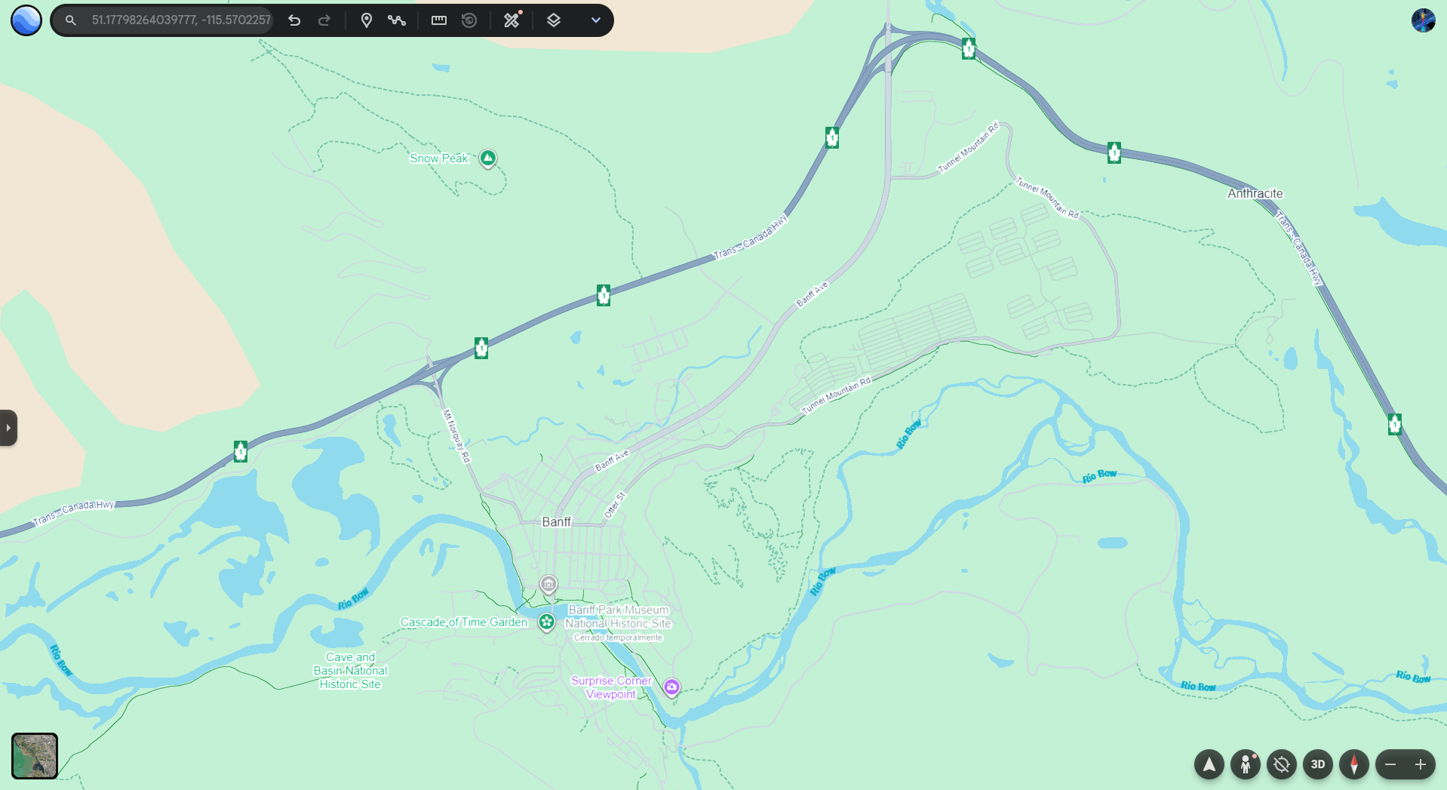

West entrance
Blinkay App
East entrance
Downtown Zone
28 Parking lots
Bridge
Mountain Ave
1 Parking Zone

